Slide 1



PCET’S
PIMPRI CHINCHWAD COLLEGE OFENGINEERING,PUNE
GDGC PCCOE
TITLE : AGRILINK
subtitle : DIRECT FARMER -TO - CONSUMER MARKETPLACE
Team : CODEFUSION
Team Lead :BC SAI HARIKA
Teammember :KURUBA.SWAPNA
Team member :B.AKSHARA

Slide 2
PCET’S
PIMPRI CHINCHWAD COLLEGE OFENGINEERING,PUNE
GDGC PCCOE
Overview of the Solution:
How it Addresses the Problem:
Innovation and Uniqueness:
mobile & web-based platform* t
mobile & web-based platform that eliminates intermediaries by:
Enabling direct farmer-to-consumer connections
Providing real-time buyer matching & negotiations
Offering seamless order management & payments
Removes Middlemen→ Farmers earn more, consumers pay less.
Direct Buyer-Seller Interaction→ Real-time price negotiation & order management.
Location-Based Matching → Reduces transport costs & ensures freshness.
Fair Pricing→ AI-driven price suggestions & transparent transactions.
Seamless Digital Platform→ Mobile & web-based, user-friendly interface.
AI-Driven Pricing & Matching- Ensures fair prices & smart buyer-farmer connections.
Location-Based Trade- Reduces transport costs & enhances freshness.
Direct Negotiation via Chat & Voice- No middlemen, real-time communication.
Blockchain for Transparency(Future Scope)–Secure, tamper-proof transactions.
Seamless Order & Payment System Ensures smooth transactions & trust.

Slide 3

PCET’S
PIMPRI CHINCHWAD COLLEGE OFENGINEERING,PUNE
GDGC PCCOE
Key Technologies/Frameworks:
Integration & Scalability:
Key Algorithms/Processes:
Frontend:React (Web), Flutter (Mobile) – User-friendly interface.
Backend:Node.js, Express.js – Fast & scalable API handling.
Database: PostgreSQL / Firebase – Secure data storage & real-time updates.
Location Services: Google Maps API – Buyer-farmer matching.
Communication:WebSockets, Twilio – Real-time chat & voice messages.
AI & ML:TensorFlow / Scikit-learn – Price prediction & demand forecasting.
Blockchain (Future Scope): Ethereum / Hyperledger – Transparent & secure transactions.
Seamless Integration– Payment gateways, logistics APIs, cloud storage, AI-driven insights.
Scalable Architecture – Microservices, cloud-based, multi-platform support, global adaptability.
AI-Driven Pricing: Linear Regression, Random Forest Fair price suggestions.
Buyer-Farmer Matching: K-Means Clustering, Haversine Formula – Location-based recommendations.
Chat & Voice Processing:NLP (BERT), Speech-to-Text - Seamless communication.
Order Optimization: Dynamic Programming, Greedy Algorithms – Efficient logistics & stock updates.
Blockchain Transactions (Future Scope): SHA-256, Smart Contracts – Secure, transparent deals.

Slide 4
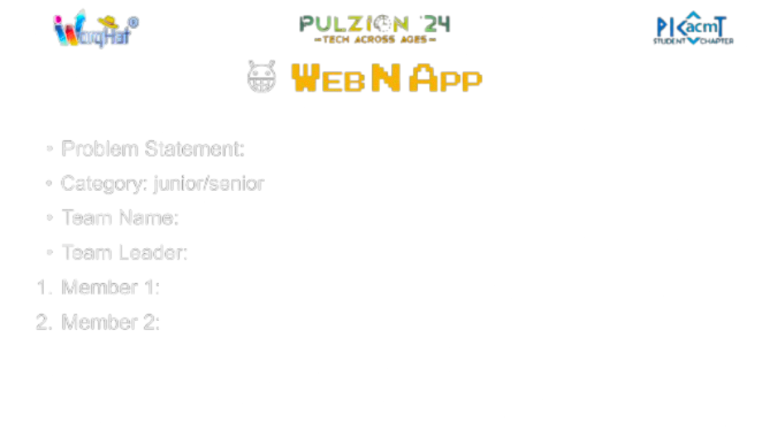
PCET’S
PIMPRI CHINCHWAD COLLEGE OFENGINEERING,PUNE
GDGC PCCOE
Feasibility Analysis:
Strategies for Overcoming Challenges:
Potential Challenges and Risks:
.
Technical Feasibility – Uses proven tech (React, Node.js, AI, Blockchain) for scalability & efficiency.
Economic Feasibility – Low development costs; revenue from subscriptions, commissions & premium features.
Operational Feasibility – User-friendly UI; easy onboarding for farmers & buyers.
Market Feasibility– High demand for direct farm-to-consumer models; scalable for global markets
Farmer Onboarding & Adoption – Simple UI, regional language support, training programs.
Trust & Transparency – AI-driven fair pricing, blockchain for secure transactions.
Logistics & Delivery – Partner with local transport services, optimize routes using AI.
Market Penetration– Collaborate with co-ops, government, and agri-tech firms.
Scalability & Performance– Cloud-based infrastructure, microservices architecture.
Farmer Digital Adoption– Resistance to tech; requires training & local language support.
Trust Issues– Farmers & buyers may hesitate; needs secure payments & verified profiles.
Logistics & Delivery – Ensuring timely, cost-effective transport for fresh produce.
Market Competition – Competing with existing platforms & middlemen resistance.
Scalability & Security– Managing high traffic, preventing fraud, ensuring data privacy.

